Slide 1

Introduction to Single Page Applications
C.K.Leng

Slide 2
What Is a Single Page Application (SPA)?
A Single-Page Application (SPA) is a web application or website that interacts with the user by dynamically rewriting the current web page rather than loading entire new pages from a server.
Instead of the browser fetching a completely new HTML document for every interaction, an SPA loads a single "shell" page and then uses JavaScript to update only the specific parts of the content that need to change.

Slide 3
What Is a Single Page Application (SPA)?
Key Characteristics
  No Full Page Reloads: Navigation and interactions happen instantly without the browser's "refresh" trigger or a blank screen between views.
  Client-Side Rendering (CSR): Most of the rendering logic is moved from the server to the browser. The server typically sends raw data (often in JSON format) which the browser then uses to update the display.
  Fluid User Experience: By avoiding page reloads, SPAs provide a smooth, responsive feel like a desktop or native mobile application.
  Upfront Loading: All necessary HTML, CSS, and JavaScript code is often retrieved in a single initial load, or smaller chunks are loaded as needed.

Slide 4
What Is a Single Page Application (SPA)?
You likely use SPAs every day without realizing it:
  Gmail: Navigation between your inbox, sent mail, and individual messages occurs without a full- page refresh.
  Social Media: Sites like Facebook, Twitter/X, and Instagram use SPA technology to keep feeds updated seamlessly.
  Entertainment: Netflix and Spotify load new content dynamically as you browse their libraries.
  Productivity Tools: Google Maps, Trello, and Slack rely on SPAs for real-time responsiveness

Slide 5
What Is a Single Page Application (SPA)?
Few Driving factors:
  Software as A Service
  Online games

Slide 6
SPA Workflow
loading a single HTML page and dynamically updating content via JavaScript without reloading the entire page
Key Stages of an SPA Workflow
  Initial Request: The user navigates to the URL, and the server sends a single HTML page along with necessary CSS and JavaScript files.
  Initial Load: The browser loads the app shell, which remains static.
  Navigation & Routing: When a user interacts with the app (e.g., clicking a link), the SPA's client-side router handles navigation, preventing a full page reload.
  Data Fetching (API Calls): The application uses APIs (via Fetch or AJAX) to request only the necessary data (often in JSON format) from the server.
  Dynamic Updating (Rendering): The browser uses the retrieved data to dynamically rewrite the content of the current page's Document Object Model (DOM).

Slide 7
Traditional Web Application Architecture
A 3-tier architecture is a well-established software design pattern that organizes applications into three logical and physical computing tiers—Presentation, Application, and Data—to improve scalability, security, and maintainability. It separates user interaction from backend logic and data storage, allowing independent updates and scaling of each layer.

Slide 8
Traditional Web Application Architecture
Web/Presentation Layer
  Purpose: The top-most level of the application. It is the interface the user interacts with directly (e.g., a web browser or mobile app).
  Main Function: It displays information to the user and communicates with the other tiers by sending results to the browser/client.
Application Layer
  Purpose: The "brain" of the application. This layer is pulled out from the presentation tier to control the application’s functionality by performing detailed processing.
  Main Function: It handles business logic, data processing, and complex calculations. It acts as a bridge between the user interface and the data.
Data Layer
  Purpose: The back-end where all the application's information is stored and managed.
  Main Function: It consists of database servers (like MySQL, PostgreSQL, or Oracle) that store data independently of application servers or business logic.

Slide 9
SPA Advantages
Faster User Experience: Reduced data transfer after the initial load leads to improved responsiveness and a smoother experience.
Decoupled Development: The front-end (UI) and back-end (API) are separated, allowing for independent development.
Rich Interaction: Like desktop applications, SPAs allow for highly interactive UI elements.
Reduce server workload: SPAs main utilizing client-side CPU to processing the application logic, this will make the solution more scalable than traditional multi-tiers architecture.

Slide 10
SPA Challenges
SEO Challenges: Search engines may struggle to crawl the content, requiring techniques like Server-Side Rendering (SSR).
Initial Load Time: The first load may take longer as all foundational resources are loaded upfront.

Slide 11
Implementing SPAs Using Angular 21
Implementing Single Page Applications (SPAs) in Angular 21 leverages modern features like standalone components and optimized templates to create high-performance, seamless web experiences.
Core SPA Implementation Concepts
  Single-Page Architecture: Unlike traditional apps that reload for every link, an Angular SPA loads a single index.html file and dynamically updates content using JavaScript APIs.
  Standalone Components: Angular 21 emphasizes a standalone architecture, where components manage their own dependencies, making the application modular and easier to scale.
  Angular Router: The primary tool for SPA navigation. It listens for URL changes and swaps components within a <router-outlet> without a full-page refresh.
  Advanced Templates: Angular 21 introduces capabilities like the spread operator directly within templates, simplifying how data is passed and updated in the HTML.

Slide 12
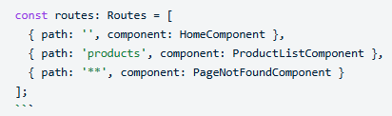
Implementing SPAs Using Angular 21
Implementation Workflow
  Project Initialization: Create a new project using the Angular CLI.
    Command: ng new my-app --routing.
  Define Routes: Set up route mappings in your application routing file.
  Use Router Outlet: Place the <router-outlet></router-outlet> directive in your main layout (e.g., app.component.html) to designate where dynamic views should load.
  Data Management with Services: Use @Injectable classes to share data and handle API calls across different views, ensuring a clean separation of concerns.

Slide 13
Implementing SPAs Using Angular 21
Scalability & Advanced Patterns
  Clean Architecture: Organize your project by separating reusable UI elements into a shared folder and core logic (services, models) into a core folder.
  Microfrontends: For large-scale enterprise apps, you can use single-spa to integrate multiple Angular apps (or even other frameworks) into a single user experience.
  SSR Integration: For improved SEO and initial load times, Angular 21 supports robust Server-Side Rendering (SSR) patterns, including hydration data management for backend integrations like .NET 10.

Slide 14
SPA Using Standalone Components
Building an Angular Single Page Application (SPA) with standalone components allows you to create modern, lightweight applications without the need for NgModules. This approach, stable since Angular 15, simplifies the project structure and improves performance through better tree-shaking
Key Concepts
  Standalone Flag: You mark a component as standalone by setting standalone: true in its @Component decorator.
  Explicit Imports: Instead of relying on a central module, standalone components must explicitly list their dependencies (like CommonModule or other components) in their own imports array.
  Bootstrapping: Standalone SPAs are started using the bootstrapApplication function in main.ts rather than the traditional module-based bootstrapping.

Slide 15
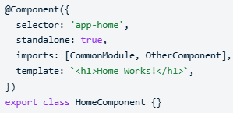
SPA Using Standalone Components
Core Architecture Steps
  Generate a Standalone App:
    In modern Angular (v17+), new applications are standalone by default. You can use the Angular CLI command: ng new my-app --standalone
  Define Standalone Components:
    Create a component that manages its own dependencies:

Slide 16
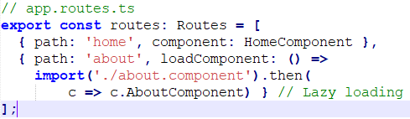
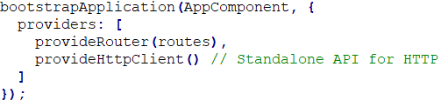
SPA Using Standalone Components
Core Architecture Steps
  Setup Routing:
    In a standalone SPA, routes are defined in a simple array and passed to the bootstrapApplication call using provideRouter:
  Bootstrap the App:
    Initialize the application in main.ts:

Slide 17
SPA Using Standalone Components
Major Benefits
  Reduced Boilerplate: Removes the need for complex app.module.ts and feature module files.
  Simplified Lazy Loading: Uses loadComponent directly in the router configuration, making it easier to offload code to separate bundles.
  Microfrontend Friendly: Their self-contained nature makes them ideal for architectures using tools like single-spa.
  Easier Testing: Dependencies are explicit and localized to the component level
For existing applications, you can use the Angular Migration Schematic by running ng generate @angular/core:standalone to automatically convert modules to the standalone pattern.

Slide 18
Component-Based Navigation
Angular 21 continues the framework's shift toward a standalone-first architecture, emphasizing signals for state and native browser APIs for navigation. Component-based navigation in version 21 revolves around mapping specific components to URL paths within a centralized routing configuration.
Core Navigation Concepts
  Routes: Objects that map a URL path to a specific component.
  Router Outlet: A <router-outlet /> placeholder in your template (usually app.component.html) where the active route's component is rendered.
  Router Links: The routerLink directive allows navigation between components without a full page reload.
  Native Navigation API (v21.1+): A new experimental feature, withExperimentalPlatformNavigation(), lets Angular delegate history management to the browser for better performance and atomic scroll restoration.

Slide 19
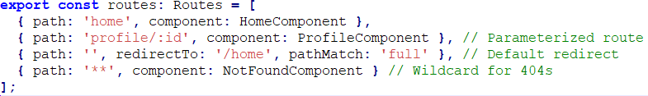
Component-Based Navigation
Implementation Workflow
  Define Routes: Create a Routes array in your configuration file.
  Provide the Router: Use provideRouter in your app.config.ts to register the routes globally.

Slide 20

Component-Based Navigation
Implementation Workflow
  Use Navigation Directives:
    In Templates: Use routerLink for clickable elements.
    In Logic: Inject the Router service to navigate programmatically.

Slide 21
Component-Based Navigation
New in Angular 21
  Enhanced Component Input Binding: Use withComponentInputBinding() with provideRouter to automatically map route parameters (like :id) directly to component @Input or signal-based inputs.
  Signal Integration: The Router now integrates more deeply with Angular's signals-based reactivity, allowing you to react to navigation state changes more efficiently than with traditional Observables.
  Aria Components: New Angular Aria headless components (like Listbox or Combobox) provide built-in keyboard navigation support, ensuring accessible UI transitions.

Slide 22

Displaying Components Dynamically
In Angular 21 (assuming current or upcoming modern Angular patterns), displaying components dynamically is typically handled through two primary methods: the declarative ngComponentOutlet directive for simpler use cases, and the imperative ViewContainerRef.createComponent for more complex programmatic.
  Declarative Approach: ngComponentOutlet
    This is the easiest way to render a component when you know which class to instantiate but want to do so conditionally in the template.
    Usage: Add the directive to an ng-container and pass the component class.
    Template Example:
    TypeScript Example:

Slide 23
Displaying Components Dynamically
  Imperative Approach: ViewContainerRef
    For more control—such as passing inputs, subscribing to outputs, or managing multiple instances—you use ViewContainerRef.
      Define a Container: Create an anchor in your HTML using ng-container and a template reference variable.
      Inject the Container: Use @ViewChild with the { read: ViewContainerRef } option in your component class.
      Create the Component: Call createComponent() on the container.

Slide 24
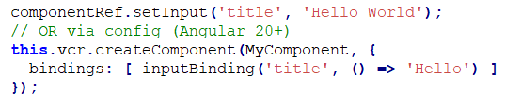

Displaying Components Dynamically
  Modern Features: Inputs and Outputs
    Modern Angular (Version 20+) has streamlined how you handle data for dynamic components using the bindings property or specific setter methods.
      Passing Inputs: Use setInput on the component reference or the bindings array in the configuration.
      Handling Outputs: Subscribe directly to the instance's EventEmitter.

Slide 25
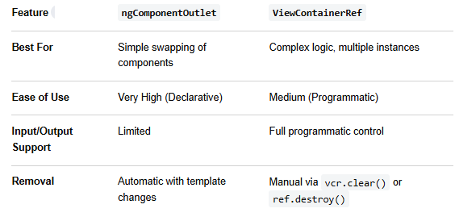
Displaying Components Dynamically
Comparison Summary

Slide 26
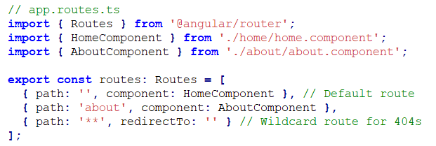
Implementing SPA Using Angular Router
Implementing a Single Page Application (SPA) in Angular 21 leverages a modern standalone architecture. In this version, the focus is on a lightweight setup using provideRouter rather than the traditional RouterModule.
  Define Your Routes
    Create a dedicated file, typically app.routes.ts, to define the mapping between URL paths and your standalone components.

Slide 27
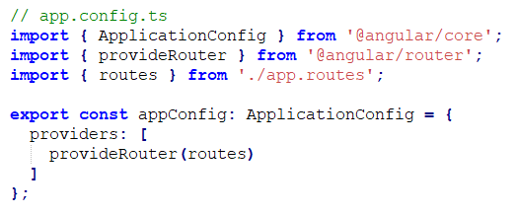
Implementing SPA Using Angular Router
  Configure the Router Provider
    In Angular 21, you register the router within the app.config.ts file using the provideRouter function. This makes the routing service available globally without needing a Module file.

Slide 28
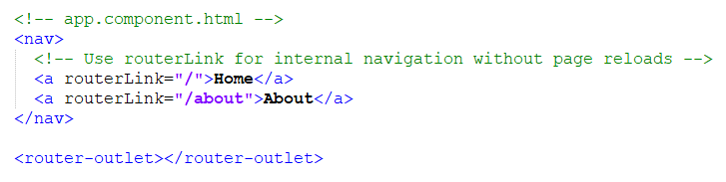
Implementing SPA Using Angular Router
  Add the Router Outlet
    The <router-outlet> directive acts as a placeholder in your main template (usually app.component.html). Angular dynamically injects the component corresponding to the current URL into this spot
  Enable Navigation
    To prevent full page refreshes—the hallmark of an SPA—always use the routerLink directive instead of standard href attributes.
      Directives to Import: Ensure RouterOutlet and RouterLink are included in the imports array of your standalone AppComponent.

Slide 29
Implementing SPA Using Angular Router
Key Features in Angular 21
  Standalone by Default: No AppRoutingModule is required; everything is handled via provideRouter().
  Performance: Use loadComponent for Lazy Loading, which ensures only the code for the active route is downloaded, speeding up initial load times.
  Signals Integration: Navigation events can be easily tracked or reacted to using Angular's new Signals API for more reactive UI updates.

